Slide 1
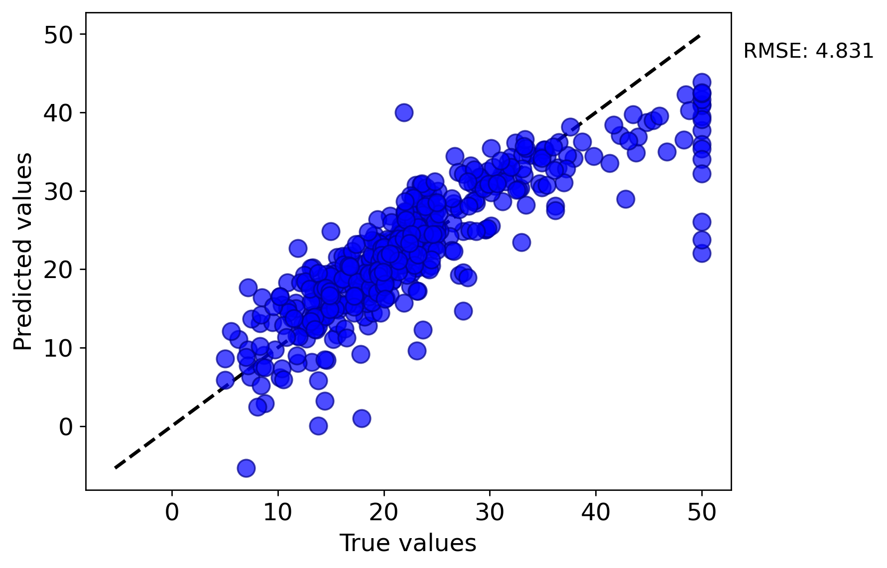
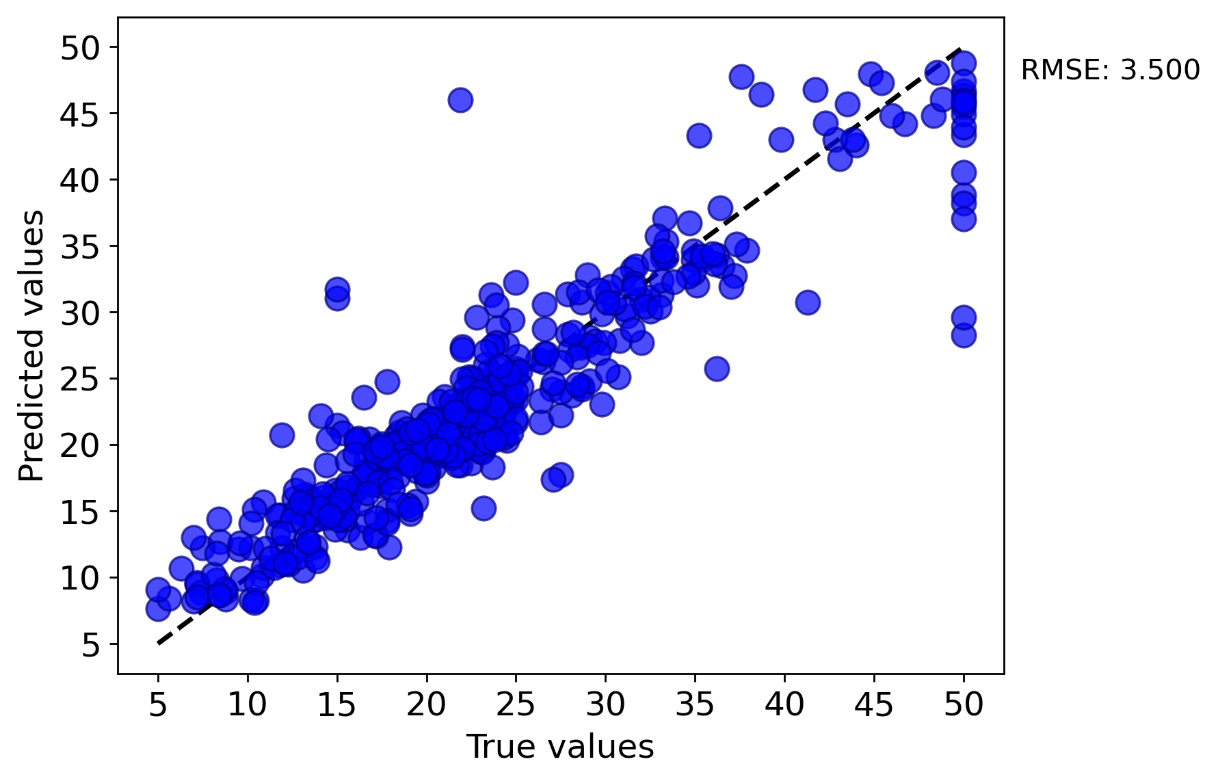
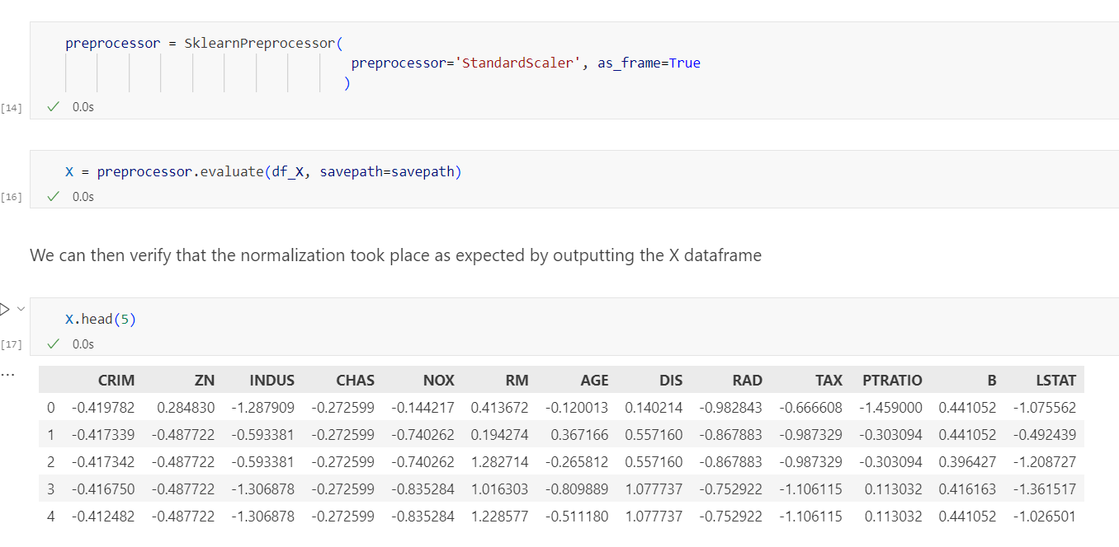
Assessment Figures

Slide 2
ML4ER Assignment 4
Jiahui Yang
Informatics Skunkworks
MSE 401, 3 Credits
Jul 31 2024

Slide 3
Progress
The normalized data has a mean of 0 and a variance of 1, confirming that the normalization process was successful.
Normalized features in “task 3”

Slide 4
Progress
5-fold CV parity plot of the linear regression model from “task 5”
The scatter plot compares true values (x-axis) and predicted values (y-axis) of a machine learning model. Each blue dot represents a data point, with the dashed line indicating ideal predictions. The RMSE is 4.831.

Slide 5
Progress
5-fold CV parity plot of the random forest regressor model from “task 6”
The scatter plot compares true values (x-axis) and predicted values (y-axis) of a machine learning model. Each blue dot represents a data point, with the dashed line indicating ideal predictions. The RMSE is 3.500.

Slide 6
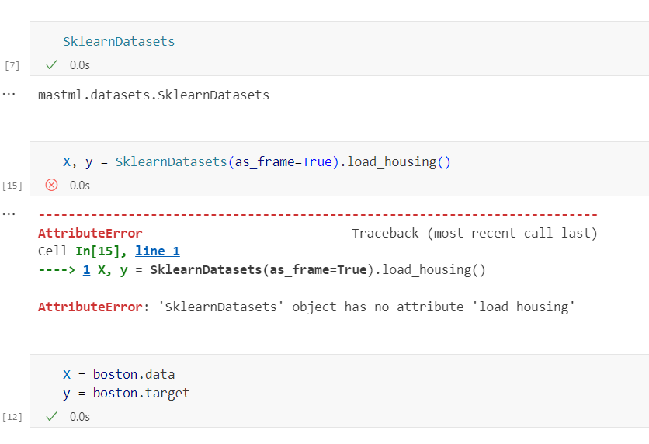
Problems
I need to use another way to import data.

Slide 7
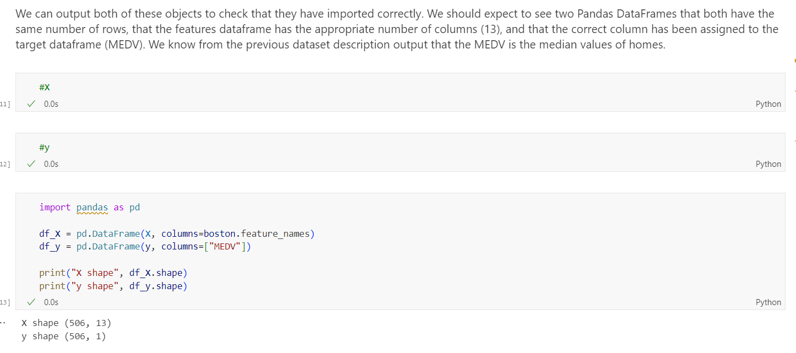
Problems
The data needs to be converted into a DataFrame for ML training.

Slide 8
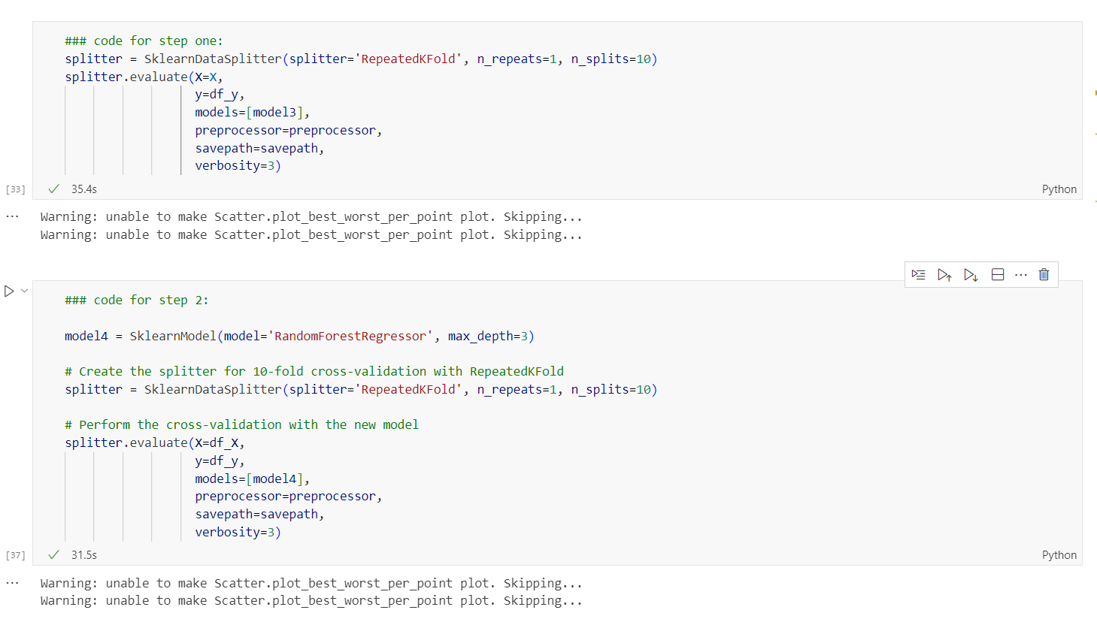
Questions
I tried running the last task but am not sure if I am on the right track. Could you please help me review the steps and confirm if everything is correct?

Slide 9
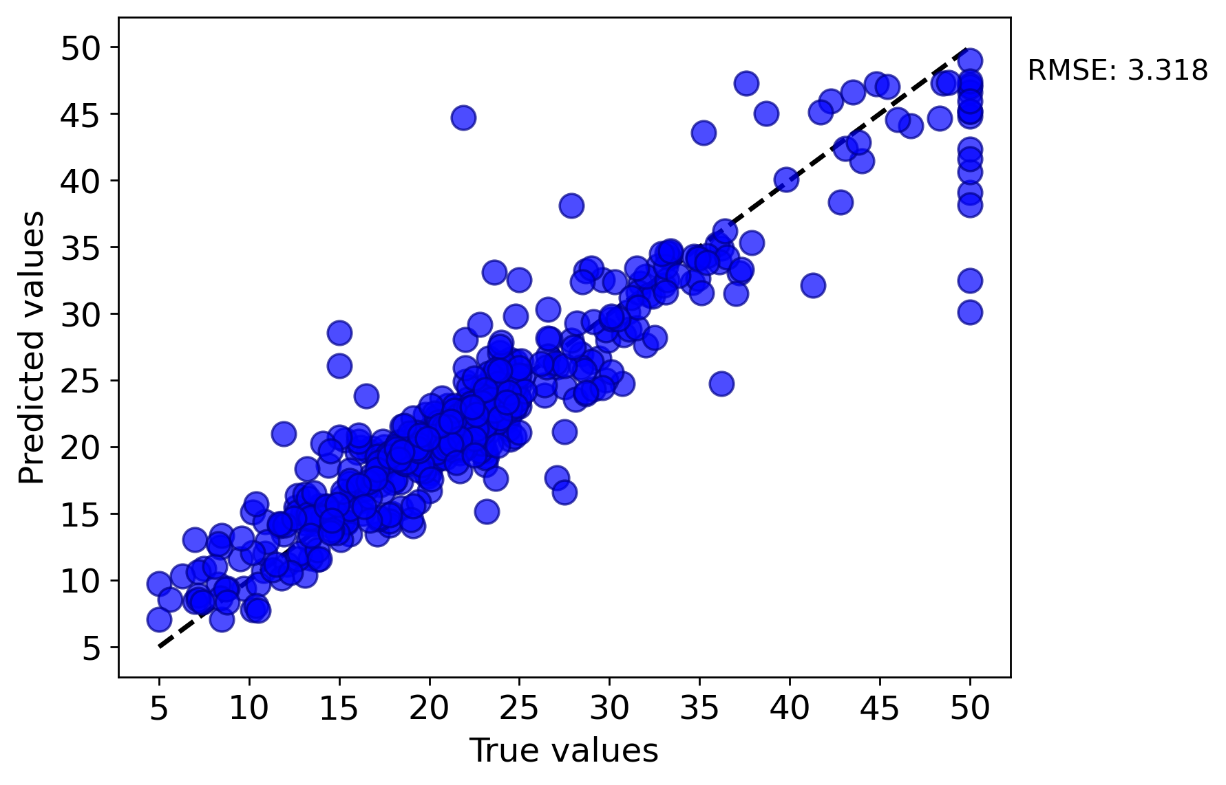
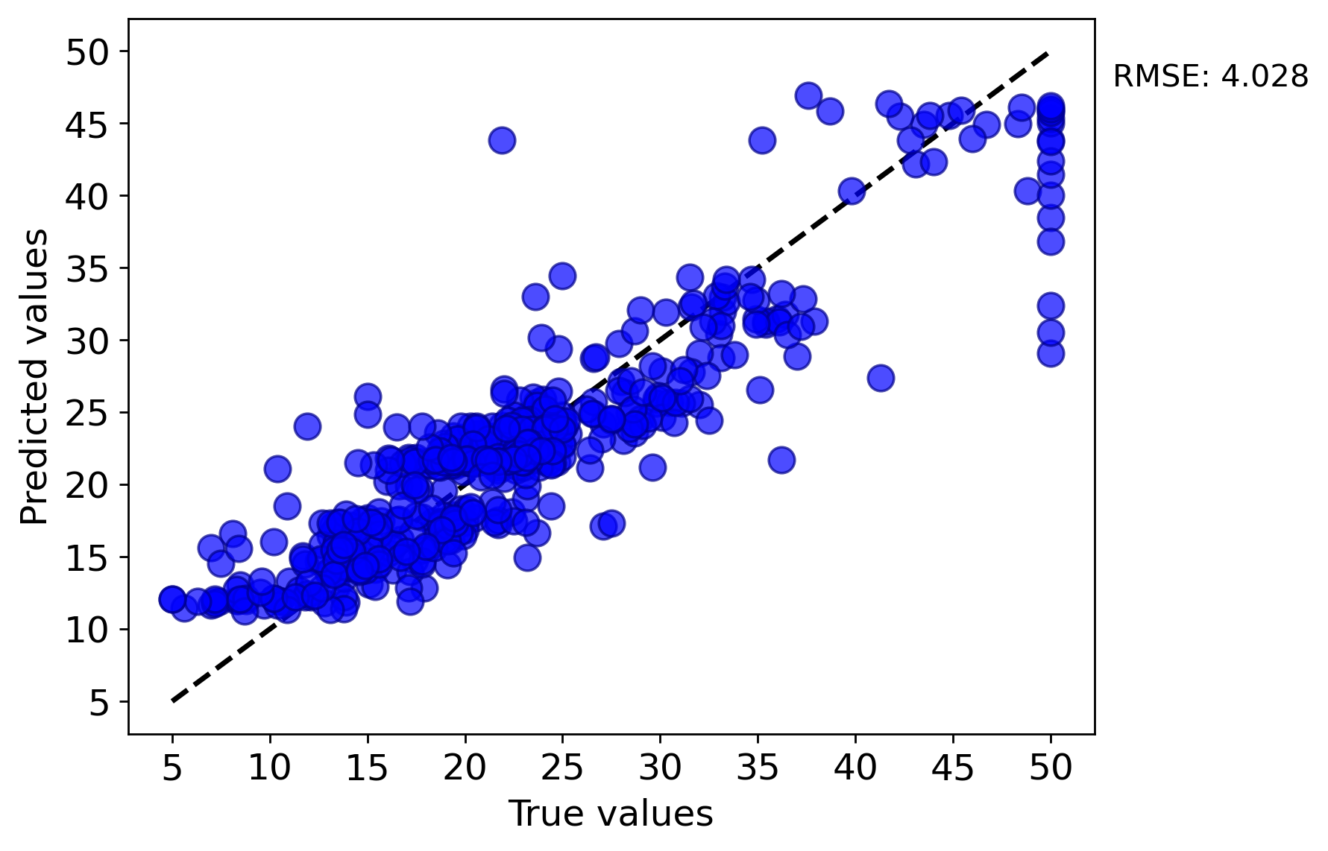
Questions
I tried running the last task but am not sure if I am on the right track. Could you please help me review the steps and confirm if everything is correct?

Slide 10
Hours Summary
Date | Hours | Description of Work
07/27/2024 | 35 min | Complete Introduction to MAST-ML activity

